Slide 1

视频压缩技术 II Basic Video Compression Techniques
授课教师：张小燕
邮箱：xyzhang15@szu.edu.cn
2021年春季课程

Slide 2
知识点回顾
Introduction to Video Compression
Video Compression with Motion Compensation
Motion Compensation
Sequential Search
Logarithmic Search
Hierarchical Search

Slide 3
Video Compression with Motion Compensation (运动补偿)
Temporal redundancy (时间冗余) exists between consecutive (连续的) frames
Not every frame of the video needs to be coded independently (独立的) as a new image
The difference between the current frame and other frame(s) in the sequence will be coded.
Steps of video compression based motion compensation (MC)
Motion estimation
MC-based prediction
Derivation of the prediction error

Slide 4
Macroblocks and Motion Vector in Video Compression
MV search is usually limited to a small immediate neighborhood — both horizontal and vertical displacements in the range [−p, p].
This makes a search window of size (2p + 1) × (2p + 1).

Slide 5
Search for Motion Vectors
The difference between two macroblocks can be measured by Mean Absolute Difference (MAD)，平均绝对误差
The goal of the search is to find a vector (i, j) as the motion vector MV = (u,v), such that MAD(i, j) is minimum
(u, v) = [ (i, j) | M AD(i, j) is minimum, i ∈ [−p, p], j ∈ [−p, p] ]

Slide 6

Sequential Search （顺序搜索）
-P
P=7
N=5
-P
+P

Slide 7
2D Logarithmic Search for Motion Vectors
O(log p*N²)
The total operations per second is dropped to:
Save a lot cost than sequential search O(p²N²)

Slide 8
A Three-level Hierarchical Search for Motion Vectors
Original image is at Level 0, images at Levels 1 and 2 are obtained by down-sampling from the previous levels by a factor of 2, and the initial search is conducted at Level 2.
Since the size of the macroblock is smaller and p can also be proportionally reduced, the number of operations required is greatly reduced.

Slide 9
练习题

Slide 10
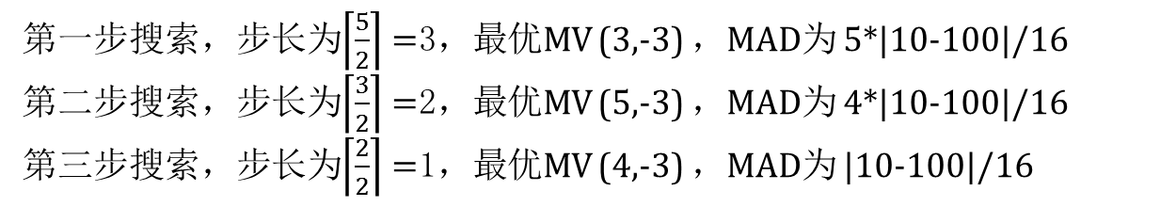
练习题
x
2
2
2
3
3
3
1
1
2
1
3
2
3
3
3
3
2
2
2
1
1
1
1
1
y

Slide 11
编码标准
H.261编码标准介绍; H.261里面的I FRAME，和P FRAME 概念和编码过程。
介绍MPEG编码，MPEG-1编码中的运动补偿，与H.261的主要区别

Slide 12
H.261 Frame Sequence
H.261: An earlier
digital video
compression
standard, its
principle of MC-based compression
is retained
in all
later
video compression standards.
The standard was designed for videophone, video conferencing and other audiovisual services over ISDN（综合业务数字网）.
The video codec supports bit-rates of p × 64 kbps, where
p ranges from 1 to 30 (Hence also known as p ∗ 64).
Require that the delay of the video encoder be less than 150 msec so that the video can be used for real-time bi- directional video conferencing.
Notes:
1990 年被采纳为国际标准。ISDN是一个数字电话网络国际标准

Slide 13
H.261 Frame Sequence
Two types of image frames: Intra-frames (I-frames，帧内编码) and Inter-frames (P-frames，帧间编码)
I-frames are treated as independent (spatial redundancy removal)
P-frames are not independent: coded by a forward predictive coding method (prediction from a previous I-frame or P-frame)
P-frame coding includes spatial redundancy removal and temporal redundancy removal, whereas I-frame coding includes spatial redundancy removal
p = 15 in motion vectors of H.261

Slide 14
H.261 Frame Sequence

Slide 15
Intra-frame (I-frame) Coding
For each macroblock
For each
8 × 8 block
C_{b}
Y
 | DCT Quantization Entropy coding
Cr
I − frame
1010010 ···
Fig. 10.5:
I-frame Coding.
Macroblocks are of size 16 × 16 pixels for the Y frame, and 8 × 8 for Cb and Cr frames, since 4:2:0 chroma subsampling is employed. A macroblock consists of four Y, one Cb, and one Cr 8 × 8 blocks.
For each 8 × 8 block a DCT transform is applied, the DCT coefficients then go through quantization zigzag scan and entropy coding.

Slide 16
Inter-frame (P-frame) Coding
For each macroblock in the Target frame, a motion vector is allocated by one of the search methods discussed earlier.
A difference macroblock is derived to measure the prediction error.
Each of these 8 × 8 blocks go through DCT, quantization, zigzag scan and entropy coding procedures.

Slide 17
Quantization in H.261
The quantization in H.261 uses a constant step_size, for all DCT coefficients within a macroblock
for DC coefficients

Slide 18
H.261 Encoder
Quantization Control Intra−frame
Output Buffer
Output Code
Current 1
3
DCT
Q
VLE
−
Frame
Inter−frame
_{Q}−1
IDCT
Intra−frame
4
0
5
+
Inter−frame
6
MC−based Prediction
Frame Memory
Prediction
2
Motion Estimation
Motion vector
(a) Encoder

Slide 19
H.261 Encoder
Quantization Control Intra−frame
Output Buffer
Output Code
Current 1
DCT
Q
VLE
Frame
_{Q}−1
IDCT
Intra−frame
4
0
5
+
6
Frame Memory
Motion vector
(a) Encoder

Slide 20
H.261 Decoder
Quantization Control
Input Buffer
Input Code
VLE
_{Q}−1
IDCT
Intra−frame
1
0
3
+
4
Decoded Frame
Inter−frame
MC−based Prediction
Frame Memory
Prediction
2
Motion vector
(b) Decoder

Slide 21
编码标准
H.261编码标准介绍; H.261里面的I FRAME，和P FRAME 概念和编码过程。
介绍MPEG编码，MPEG-1编码中的运动补偿，与H.261的主要区别

Slide 22
MPEG Overview
MPEG: Moving Pictures Expert Group(运动图像专家组), established in 1998 for the development of digital video
It is appropriately recognized that proprietary interests need to be maintained within the family of MPEG standards
Accomplished by defining only a compressed bitstream that implicitly defines the decoder
The compression algorithms, and thus the encoders, are completely up to the manufacturers
MPEG标准主要有以下五个，MPEG-1、MPEG-2、MPEG-4、MPEG-7及MPEG-21等
Notes:
该专家组建于1988年，专门负责为CD建立视频和音频标准，而成员都是为视频、音频及系统领域的技术专家。及后，他们成功将声音和影像的记录脱离了传统的模拟方式，建立了ISO/IEC11172压缩编码标准，并制定出MPEG-格式，令视听传播方面进入了数码化时代。
MPEG标准的视频压缩编码技术主要利用了具有运动补偿的帧间压缩编码技术以减小时间冗余度，利用DCT技术以减小图像的空间冗余度，利用熵编码则在信息表示方面减小了统计冗余度。这几种技术的综合运用，大大增强了压缩性能。

Slide 23
MPEG-1
The MPEG-1 was approved by the (ISO/IEC) MPEG group in November 1991
Coding of Moving Pictures and Associated Audio for Digital Storage Media ，CDs ，VCDs
at up to about 1.5 Mbit/s
MPEG-1 adopts the CCIR601 digital TV format also known as SIF (Source Input Format)
MPEG-1 supports only non-interlaced (非隔行) video. It uses 4:2:0 chroma subsampling
The MPEG-1 standard is also referred to as ISO/IEC 11172. It has five parts: 11172-1 Systems, 11172-2 Video, 11172-3 Audio, 11172-4 Conformance, and 11172-5 Software

Slide 24
Motion Compensation in MPEG-1
Motion Compensation (MC) based video encoding in H.261 works as follows:
In Motion Estimation (ME), each macroblock (MB) of the Target P-frame is assigned a best matching MB from the previously coded I or P frame - prediction.
prediction error: The difference between the MB and its matching MB, sent to DCT and its subsequent encoding steps.
The prediction is from a previous frame — forward prediction.

Slide 25
The Need for Bidirectional Search
Previous frame
Target frame
Next frame
The Need for Bidirectional Search.
The MB containing part of a ball in the Target frame cannot find a good matching MB in the previous frame because half of the ball was occluded by another object. A match however can readily be obtained from the next frame.

Slide 26
Motion Compensation in MPEG-1
MPEG introduces a third frame type — B-frames, and its accompanying bi-directional motion compensation.
The MC-based B-frame coding idea is :
Each MB from a B-frame will have up to two motion vectors (MVs) (one from the forward and one from the backward prediction).
If matching in both directions is successful, then two MVs will be sent and the two corresponding matching MBs are averaged (indicated by ‘%’ in the figure) before comparing to the Target MB for generating the prediction error.
If an acceptable match can be found in only one of the reference frames, then only one MV and its corresponding MB will be used from either the forward or backward prediction.

Slide 27
B-frame Coding Based on Bidirectional Motion Compensation
have up to two motion vectors (MVs)
two corresponding matching MBs are averaged

Slide 28
B-frame Coding Based on Bidirectional Motion Compensation
Time
1
2
3
4
5
6
7
8
9
10
Display order Coding and
transmission order
I
B
B P B B
P B B
I
I
P
B B P
B B I
B
B
1 4 2 3 7 5 6 10 8 9
MPEG Frame Sequence.

Slide 29
Typical Sizes of MPEG-1 Frames
The typical size of compressed P-frames is significantly smaller than that of I-frames — because temporal redundancy is ex- ploited in inter-frame compression.
B-frames are even smaller than P-frames — because of (a) the advantage of bi-directional prediction and (b) the lowest priority given to B-frames.
Table 11.4: Typical Compression Performance of MPEG-1 Frames
Type | Size | Compression
I | 18 kB | 7:1
P | 6 kB | 20:1
B | 2.5 kB | 50:1
Avg | 4.8 kB | 27:1

Slide 30
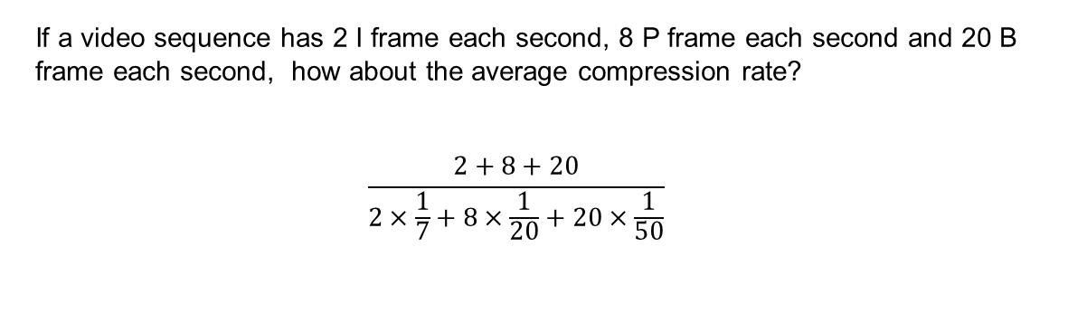
Typical Sizes of MPEG-1 Frames
Type | Size | Compression
I | 18 kB | 7:1
P | 6 kB | 20:1
B | 2.5 kB | 50:1
Avg | 4.8 kB | 27:1

Slide 31
编码标准
H.261编码标准介绍; H.261里面的I FRAME，和P FRAME 概念和编码过程，H.261的量化过程。
介绍MPEG编码，MPEG-1编码中的运动补偿，与H.261的主要区别

Slide 32
Overview of MPEG-4
MPEG-4: a newer standard. Besides compression, pays great attention to issues about user interactivities.
MPEG-4 departs from its predecessors in adopting a new object-based coding.
The bit-rate for MPEG-4 video now covers a large range between 5 kbps to 10 Mbps.

Slide 33
2D Mesh Object Coding
The vertices of the polygons are referred to as nodes of the mesh.
The most popular meshes are triangular meshes where all polygons are triangles.
The MPEG-4 standard makes use of two types of 2D mesh: uniform mesh and Delaunay mesh
Nodes
Delaunay Mesh

Slide 34
2D Mesh Object Coding
Mesh geometry coding:
Except for the first location (x0; y0), all subsequent coordinates are coded deferentially—— that is, for n > 1,

Slide 35
2D Mesh Object Coding
Mesh motion coding:
For any MOP triangle (Pi; Pj; Pk), if the motion vectors for Pi and Pj are known to be MVi and MVj, Predk=0.5(MVi+MVj)
The prediction error ek is coded as, ek=MVk-Predk

Slide 36
3D Model-Based Coding
MPEG-4 has adopted a generic default face model, which was developed by VRML Consortium.
Face Animation Parameters (FAPs) can be specified to achieve desirable animations，deviations from the original neutral face.
For compression, the FAPs are coded using predictive coding.

Slide 37
扩展
5G网络时代视频压缩
只有5G而没有视频压缩，那么多媒体传输一切都是0
视频流量一直是占领网络流量的先驱，在5G趋势下会只增不减
到2020年视频流量百分比可以达到82%。到2020年82%的流量是视频传输，包括视频会议、小视频、云游戏类似的服务。
https://v.qq.com/x/page/a0559imqg4y.html

Slide 38
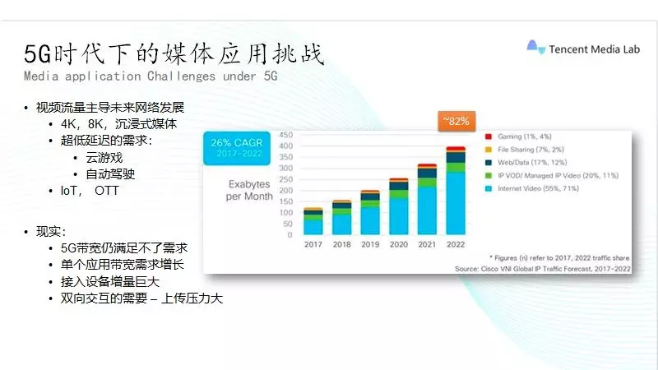
扩展
5G网络时代视频压缩
只有5G而没有视频压缩，那么多媒体传输一切都是0
视频流量一直是占领网络流量的先驱，在5G趋势下会只增不减
到2020年视频流量百分比可以达到82%。到2020年82%的流量是视频传输，包括视频会议、小视频、云游戏类似的服务。
https://v.qq.com/x/page/a0559imqg4y.html
出现新型视频压缩标准：比如VVC（H266）视频压缩标准
Notes:
一是新兴媒体格式的出现，包括4K、8K等。另外是新兴媒体的体验，比如沉浸式媒体、VR、增强现实AR、云游戏等都需要很强的带宽和低延时等网络的需求。比如自动驾驶，需要很高的网络可靠性。控制的连接设备、新兴媒体的运营模式，OTT运营比如像YouTube、NetFlix，国内的优酷等。美国NeFflix在高峰期时视频流量可以占全球65%。随着网络带宽越来越高，视频流量会越来越高，我们想要体验更高的多媒体流量只会越来越难。

